Slide 1
Chapter 1
The Nature of Science

Slide 2
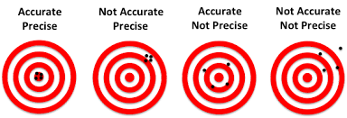
1.2 Standards of Measurement
In science, why is it important that measurements are standardized?
When you get results of an experiment, how do you know if they are precise or accurate? What’s the difference?
Notes:
Start with wanting to measure desk using hands (mine versus someone else’s)
Standards are important because they are a common way of measuring things so they can be compared.

Slide 3
1.2 Standards of Measurement
To ensure that results can be easily understood, a common system of units of measurements are used
This is called the International System, or SI for short (from the French Le system internationale d’Unites)
Each type of SI measurement has a base unit and prefixes based on multiples of 10
Why would this system be widely used, especially in science?
Notes:
Start with wanting to measure desk using hands (mine versus someone else’s)
Standards are important because they are a common way of measuring things so they can be compared.

Slide 4
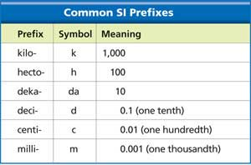
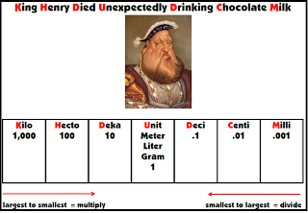
KNOW THESE!!!

Slide 5
1.2 Standards of Measurement
Measuring Distance
Base unit: meter (m)
Slightly longer than a yard
So would your time for a 100-m dash be slightly more or less than your time for a 100-yard dash?
Choose an appropriate unit
Measuring the distance from the earth to the moon is better measured in kilometers (km) than in centimeters (cm) or meters (m)

Slide 6
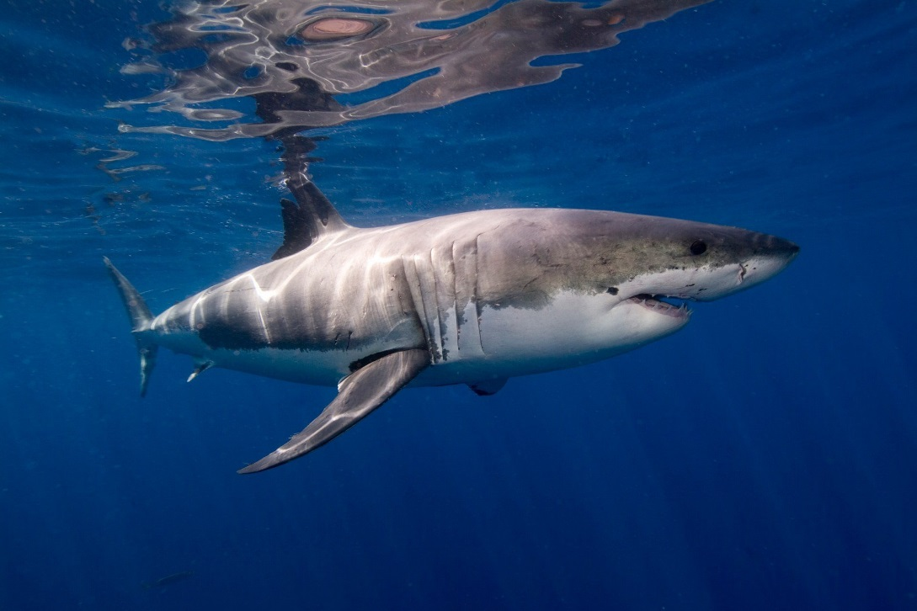
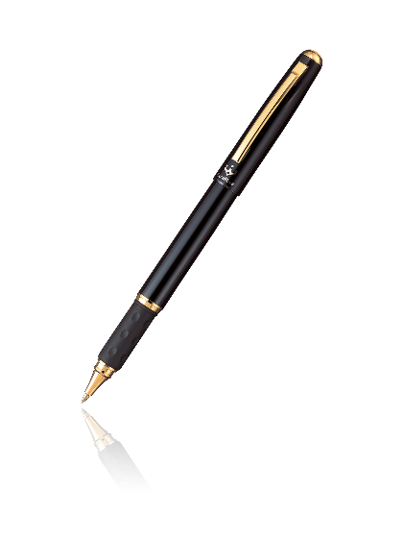
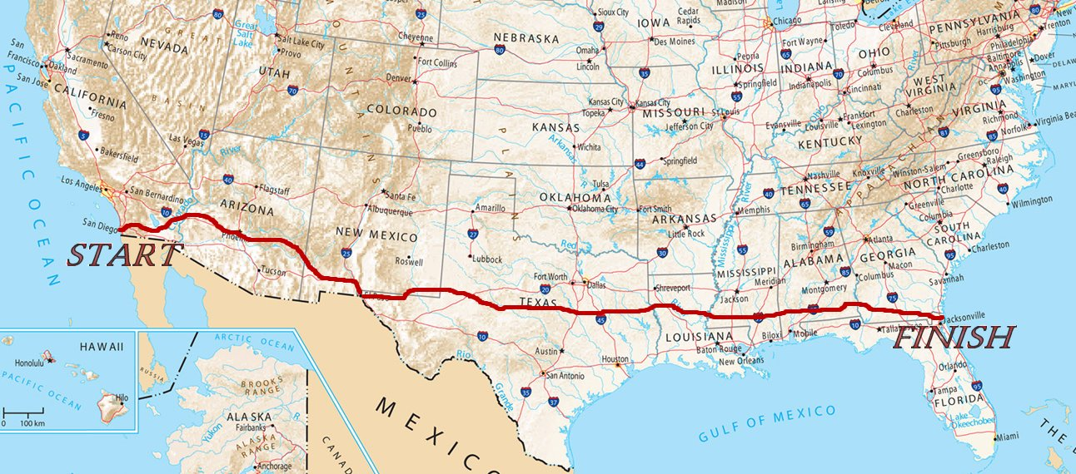
1.2 Standards of Measurement
Choose the most appropriate distance measurement for each:

Slide 7
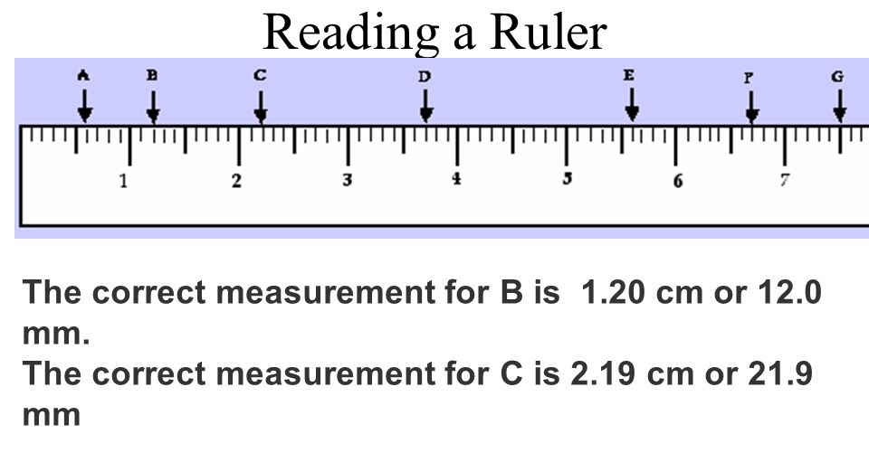
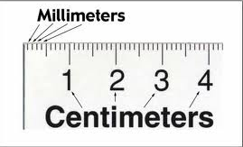
1.2 Standards of Measurement
Measuring Distance
Reading a metric ruler

Slide 8
1.2 Standards of Measurement
Measuring Volume
Volume is the amount of space occupied by an object
Volume of a solid rectangle: length x width x height
Final volume in in (units)³
If I had a brick that was 6 cm long, 4 cm wide, and 3 cm tall, what would its volume be?
Liquid Volume
Use liters (L) or milliliters (mL)
1 mL = 1 cm³

Slide 9
1.2 Standards of Measurement
Measuring Matter
Mass is a measurement of the quantity of matter in an object
Base unit: gram (g)
How do mass and weight differ?
Mass is a measurement of the amount of matter something contains
Weight is the measurement of the pull of gravity on an object

Slide 10
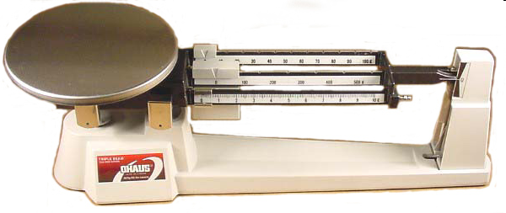
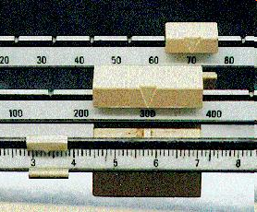
Measuring Mass
We will be using triple-beam balances to find the mass of various objects.
The objects are placed on the scale and then you move the weights on the beams until you get the lines on the right-side of the scale to match up.
Once you have balanced the scale, you add up the amounts on each beam to find the total mass.
What would be the mass of the object measured in the picture?
_______ + ______ + _______ = ________ g

Slide 11
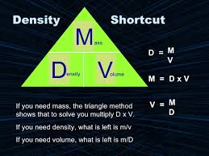
1.2 Standards of Measurement
Measuring Matter
Density
Mass per unit volume of a material
Density = mass divided by volume
d=m/v
Typically expressed in grams/centimeter³ or grams/milliliter
Remember 1 cm³ = 1 mL
What is the density of an object that has a mass of 10 g and a volume of 2 cm³?

Slide 12
1.2 Standards of Measurement
Measuring Time and Temperature
Time: measured in seconds
Temperature: typically measured in Celsius (C)
Freezing = 0°C
Boiling = 100°C
Human body temperature = 37°C
Sometimes temperature is measured in Kelvin (K)
Absolute Zero (0 K) = the coldest possible temperature
To convert Celsius to Kelvin, add 273 to the Celsius reading
Practice: Convert 27°C to Kelvin.

Slide 13
1.2 Conversions

Slide 14
Ladder Method
1
2
KILO 1000 Units
3
HECTO 100 Units
DEKA 10 Units
DECI 0.1 Unit
CENTI 0.01 Unit
MILLI 0.001 Unit
Meters Liters Grams
How do you use the “ladder” method?
4 km = _________ m
1st – Determine your starting point.
2nd – Count the “jumps” to your ending point.
3rd – Move the decimal the same number of jumps in the same direction.
Starting Point
Ending Point
How many jumps does it take?
4.
__.
__.
__.
= 4000 m
1
2
3

Slide 15
Conversion Practice
Meters Liters Grams
Try these conversions using the ladder method.
1000 mg = _______ g 1 L = _______ mL 160 cm = _______ mm
14 km = _______ m 109 g = _______ kg 250 m = _______ km
Compare using <, >, or =.
56 cm 6 m 7 g 698 mg

Slide 16
Write the correct abbreviation for each metric unit.
1) Kilogram _____ 4) Milliliter _____ 7) Kilometer _____
2) Meter _____ 5) Millimeter _____ 8) Centimeter _____
3) Gram _____ 6) Liter _____ 9) Milligram _____
Try these conversions, using the ladder method.
10) 2000 mg = _______ g 15) 5 L = _______ mL 20) 16 cm = _______ mm
11) 104 km = _______ m 16) 198 g = _______ kg 21) 2500 m = _______ km
12) 480 cm = _____ m 17) 75 mL = _____ L 22) 65 g = _____ mg
13) 5.6 kg = _____ g 18) 50 cm = _____ m 23) 6.3 cm = _____ mm
14) 8 mm = _____ cm 19) 5.6 m = _____ cm 24) 120 mg = _____ g

